Slide 1

Data Scraping, Data Visualisation and Data Modelling
Final Year Project
Aisling Smyth
April 2022

Slide 2
Semester 1
Data-scraping and app creation

Slide 3
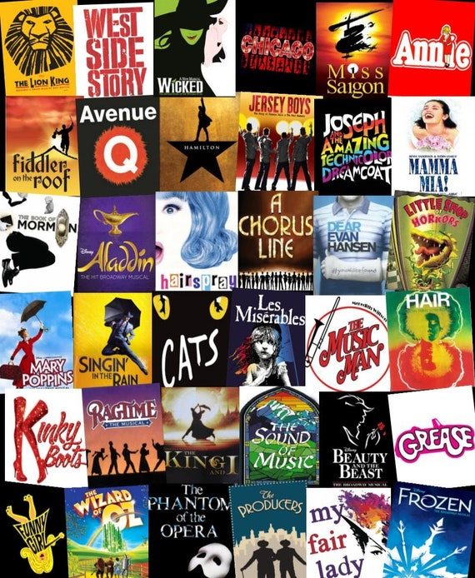
Background
This project consists of 3 main parts: web-scraping, data visualization, and finally data modelling using RStudio.
Finding data to use: researched open-source data sets and web-scraping projects online to try and get inspiration.
My big passion in life is musical theatre, so I really wanted to produce something to do with this.
So many musicals available, so I decided to create a musical-recommendation application.
Difficult to find much data with respect to live theatre, so I used IMDb to find movie musicals.

Slide 4
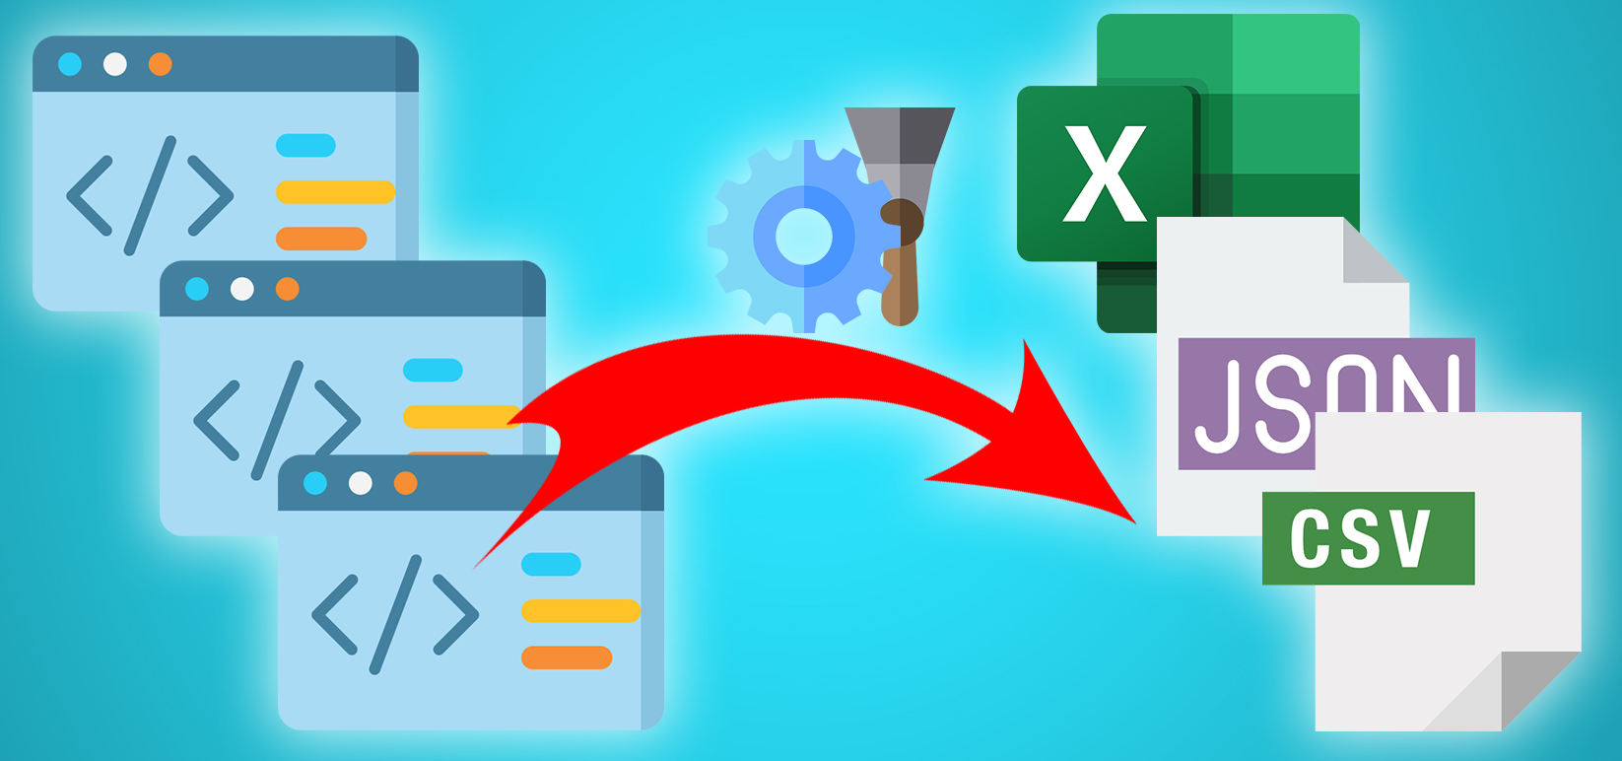
Web Scraping
Web page consists of three main programming languages: Hypertext Markup Language (HTML), Cascading Style Sheets (CSS), and JavaScript.
When scraping a web page, a combination of text matching/searching is used to find the tags we want within that page’s source code.
I did my scraping using the rvest package in Rstudio, and started by following a few tutorials.

Slide 5
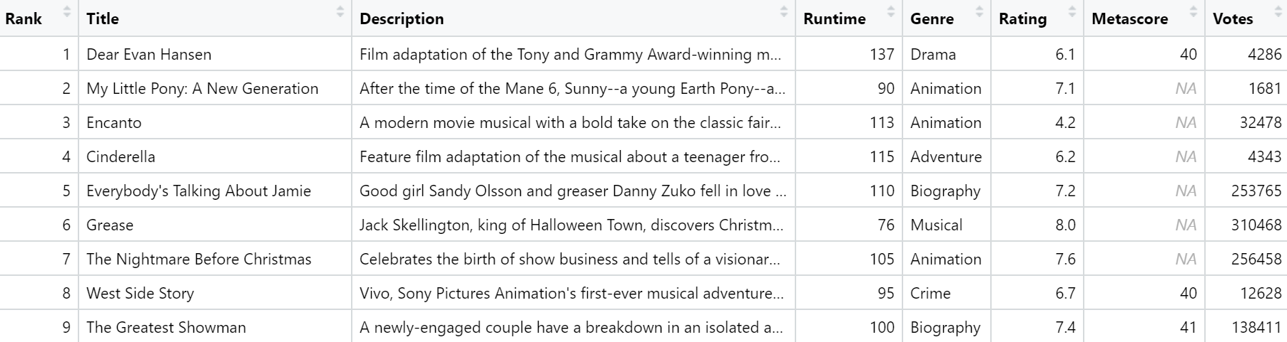
Scraping IMDb
While following tutorials, I found one which in itself scraped IMDb, however it had a few shortcomings when data was missing.
Began scraping myself ‘by movie’.
Few issues encountered regarding age ratings, descriptions and actors/directors, but after a few tries successfully scraping the data.
Finally, catered to scraping multiple pages and ended up with a dataset of the musicals’ information.

Slide 6

Data Visualization
Wanted to have a more ‘tangible’ project for the interim report, so began creating my application.
Did this using the Shiny package in Rstudio.
This is done by creating a user interface (UI) to determine what it looks like, and a server to determine what it does.

Slide 7
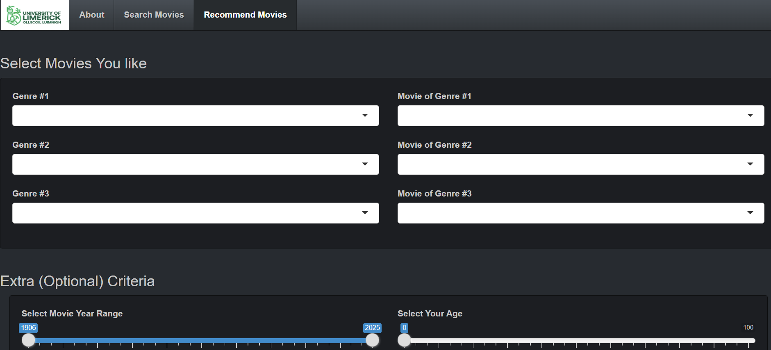
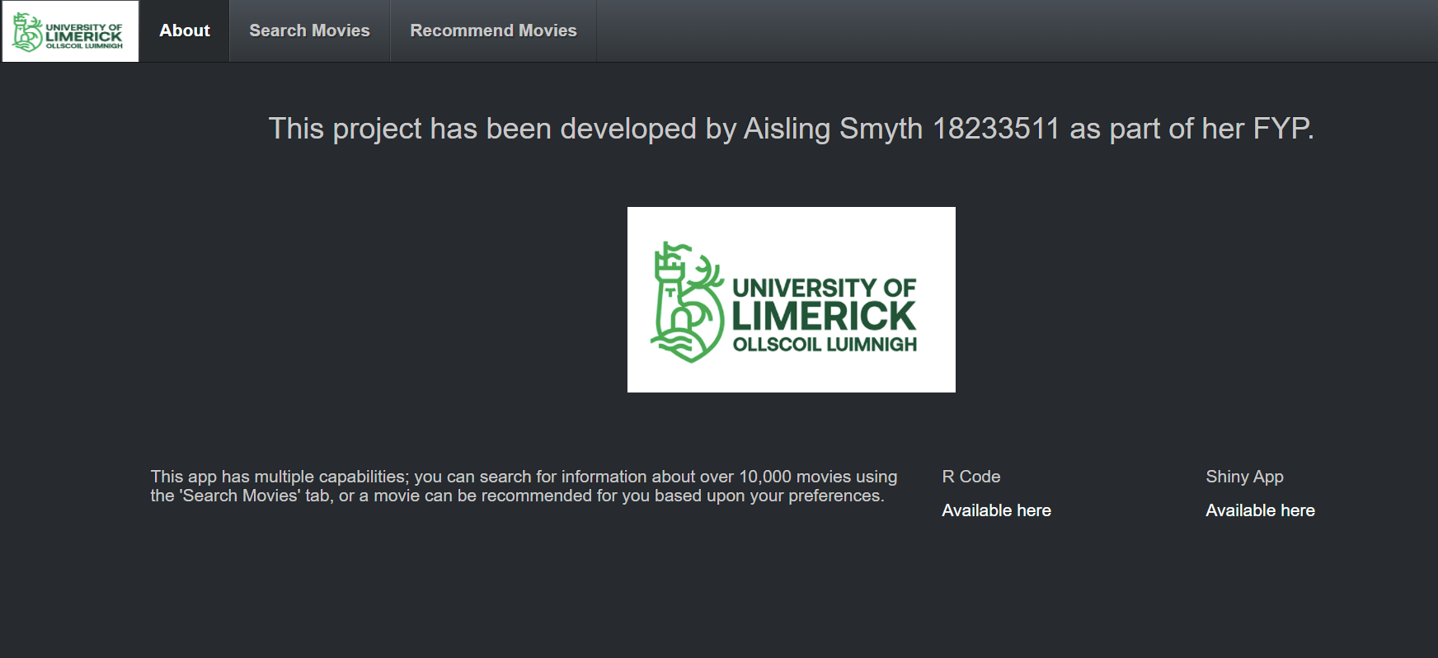
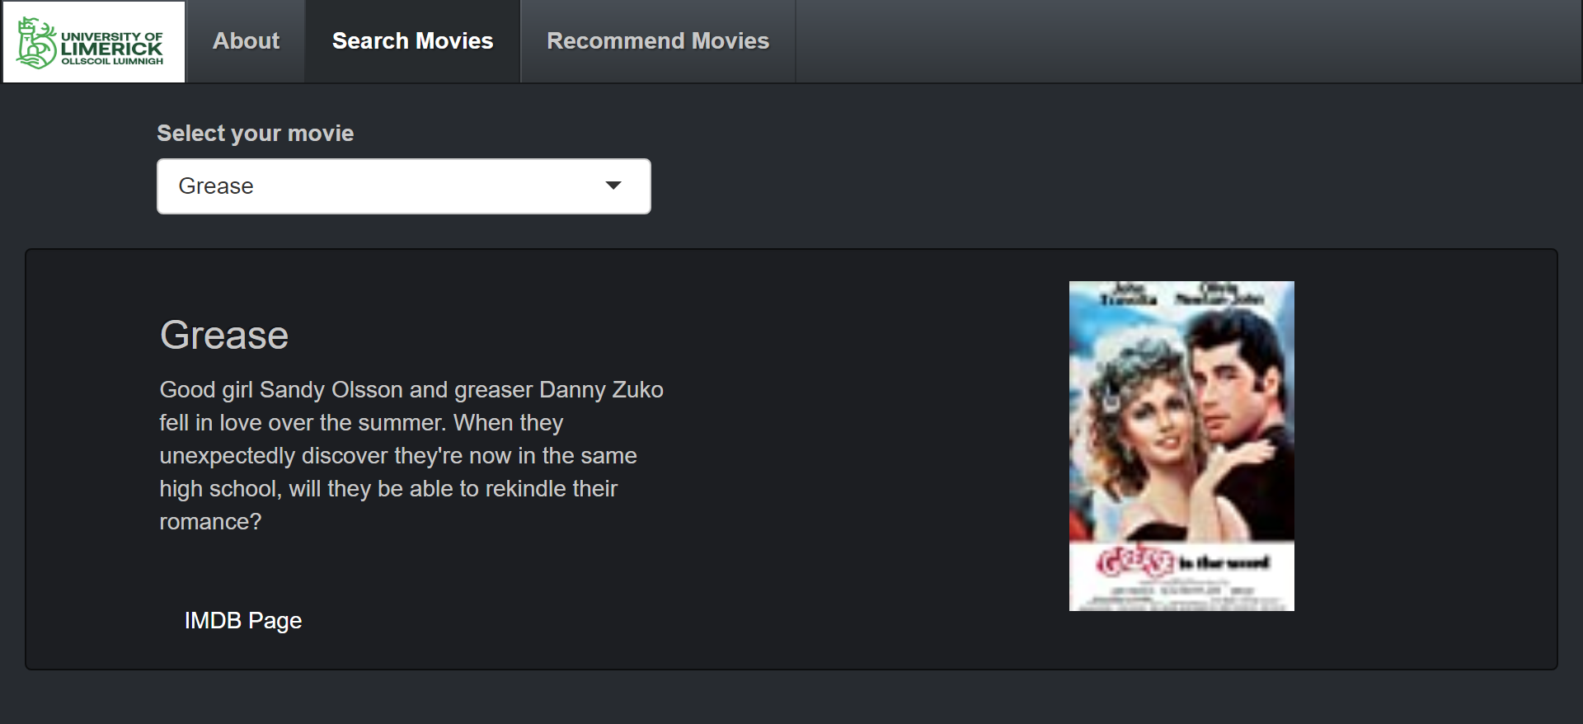
Creating My App
Found a template online I liked, and catered it to my needs.
3 tabs: ‘About’, ‘Search Movies’ and ‘Recommend Movies’.
Allows for constraints such as only certain genres, movies made in a certain date range or catering to certain age restrictions.

Slide 8
Semester 2
Creating the recommender system

Slide 9
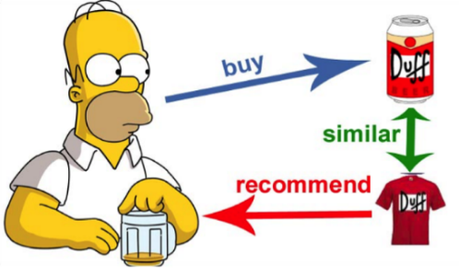
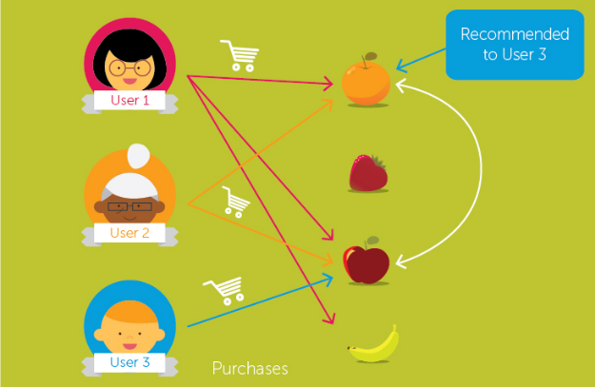
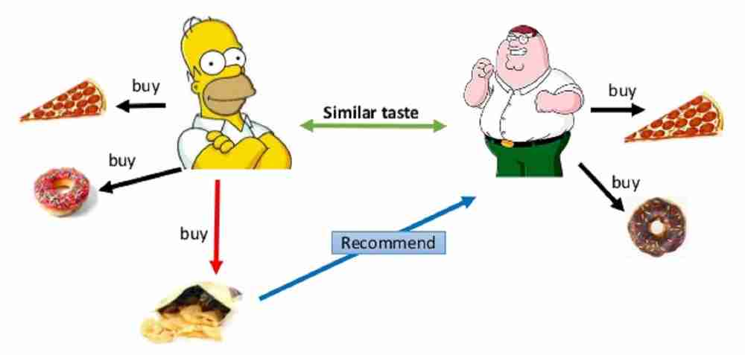
Finding Similarities
User-based collaborative filtering compares the users themselves, by inferring that users who have agreed on ratings in the past, are likely to continue to agree in future.
Item-based collaborative filtering compares the products themselves, by inferring that two items which received the same ratings from the same user, are likely to be similar.
Content-based filtering compares the products themselves, by finding new products containing similar features to a product the user previously liked.

Slide 10
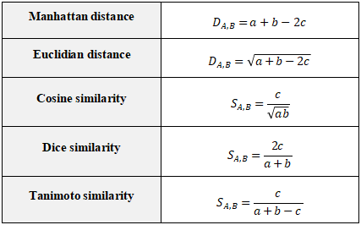
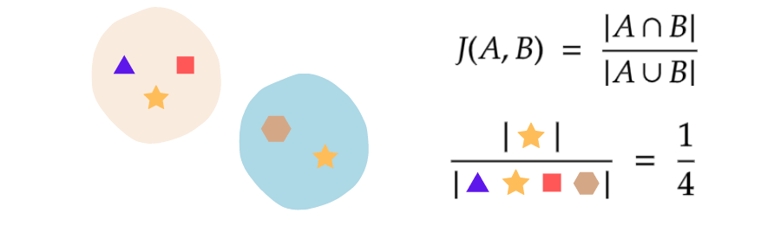
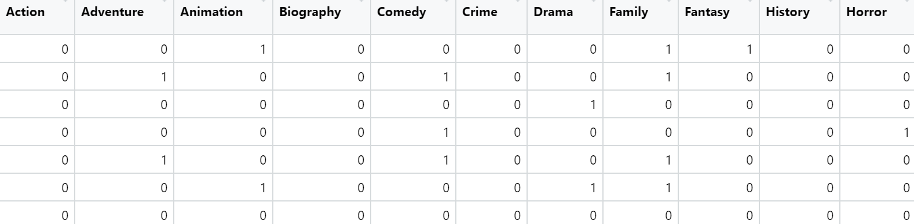
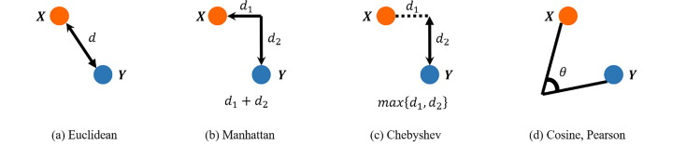
Measuring Distances
How to create recommendations: calculate distances.
Various methods, but generally get a similarity measured on the interval [0, 1].
My data is binary, so I used the Jaccard Similarity, as it caters to the fact that only attributes that do appear are important.
Calculated by finding the size of the intersection of two sets, and dividing by the size of the union.

Slide 11
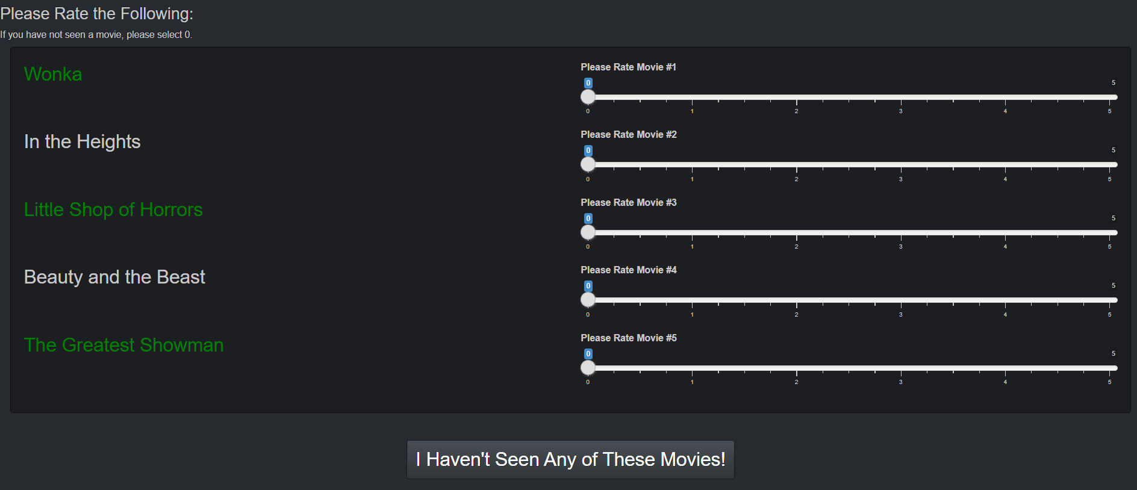
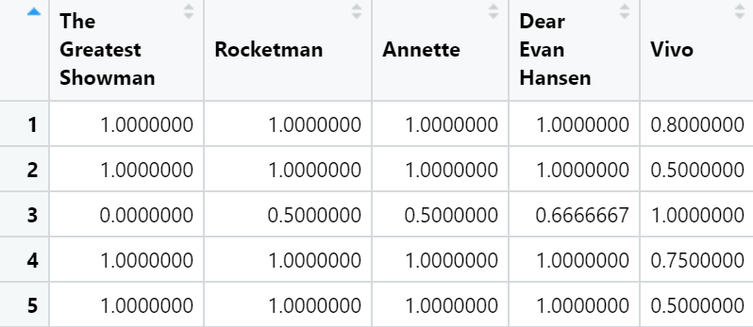
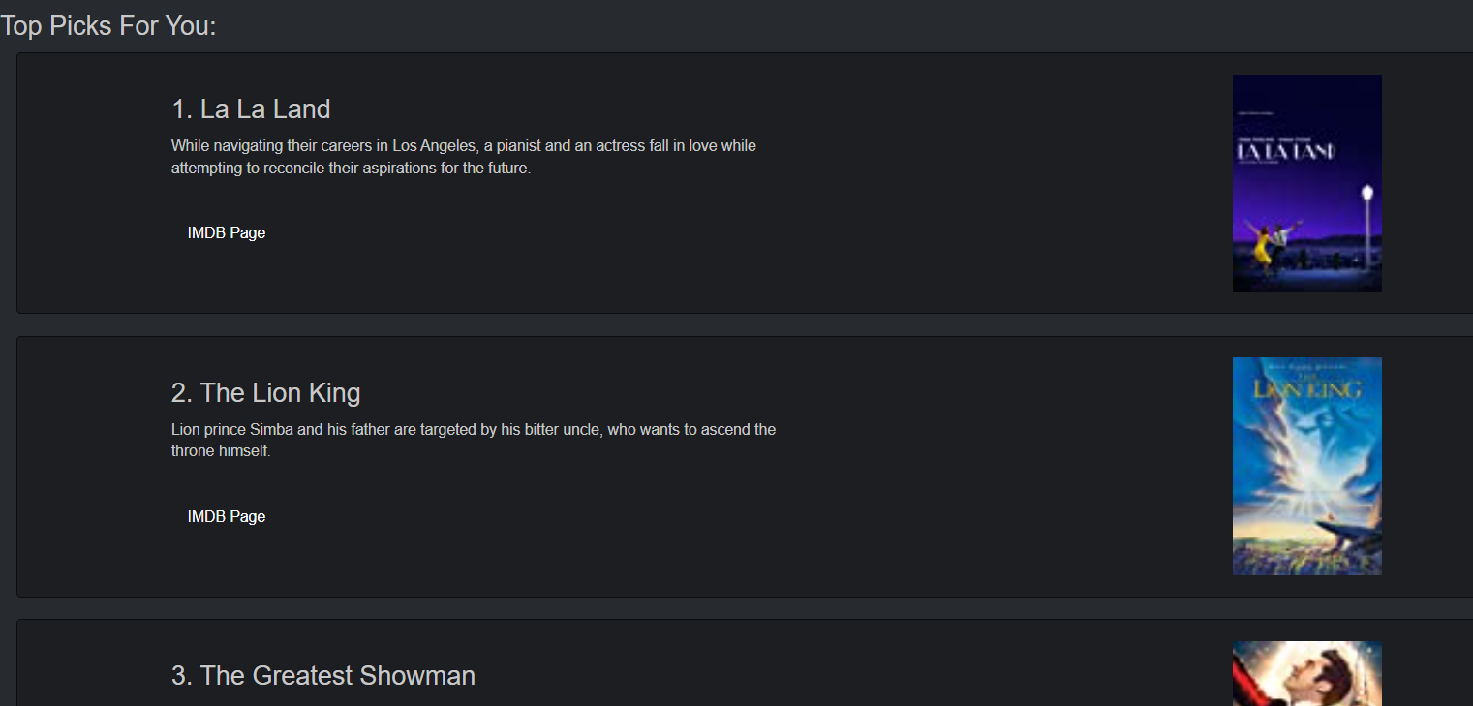
Creating Recommendations
Begin by getting user ratings (implicitly or explicitly).
Use comparison criteria and distance-based measures to find similarities.
Create a weighting formula for how to rank recommendations.
Output recommendations.

Slide 12

Possible Improvements
Re-scrape the data, to make better recommendations, and to be more visually appealing.
Incorporate the MovieLens dataset to aid in prediction-making.
Extend my function to incorporate Natural Language Processing to incorporate descriptions as part of my criteria.

Slide 13


Slide 14
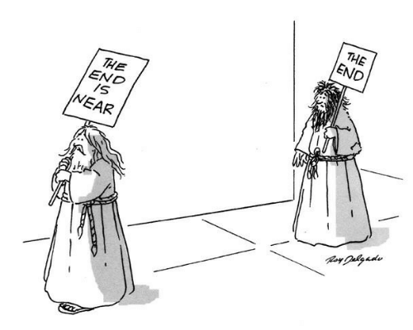
Questions at the End

